Slide 1
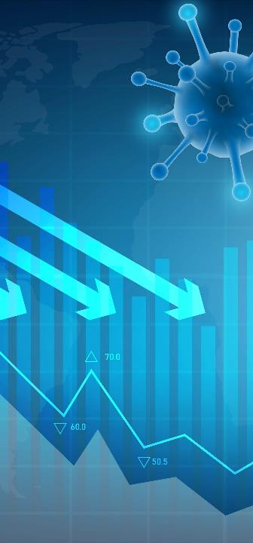
Using Pandemic Data Modeling to Inform Public Health Decisions
Ian Painter Ph.D | Senior Epidemiologist
Washington State Department of Health

Slide 2
Outline
A brief history
Primary model and data sources
ID modeling workflow
SEIR model
How we use modeling
Modeling to inform policy decisions
Implementing health equity into modeling
2
Notes:
A brief history
Primary model and data sources
Non-technical overview
How we use modeling
Understanding current situation
Short term projections
Examining possible futures
Modeling to inform policy decisions
Implementing health equity into modeling

Slide 3
Question for the Audience
During the COVID-19 pandemic, did you work with any of the following types of partners on data science projects (any project involving collecting, processing, analyzing or interpreting data)?
Academic groups
Other public health agencies
Private industry
Not-for-profit organizations
Did not partner
Other (Type in chat)
3
Notes:
During the OCVID-19 pandemic, did you with any of the following types of partners on data science projects? This would include projects involving collecting, processing, analyzing or interpreting data.

Slide 4
A brief history

Slide 5
Context
5
Source: The Seattle Times

Slide 6
Timeline: Pre-Pandemic - Present
April 2020:
COVID-19 Modeling Working Group
Present:
Model Updates
Before COVID-19 pandemic:
Early IDM work
March 2020:
IDM / DOH
Governor Briefings
2021:
Hand off to DOH
6
Notes:
The earliest modeling that the DOH made use of was results published from IDM. That directly lead to DOH seeking out information from IDM, and in mid-April we started weekly joint briefings to the governor and the Unified Group Command response lead by Admiral Bono.
Mike, Niket, Dan really lead these briefings – DOH supplied complimentary information from surveillance data. Many others from IDM briefed on other topics, such as economic/transmission tradeoffs between industries – effects of social distancing, etc.
On the DOH side we had myself, Cathy Wasserman (state epi for non-infectious conditions), Kathy Lofy, State Health Officer, and in mid 2020 Gita Singh from the CDC foundation joined our team and lead much of the DOH side of the work. Ruth Etzioni from Fred Hutch and Barbra Richardson from UW biostatistics were part of the group, and as was Juan Lavista Ferres from Microsoft AI for Health, who is now a VP at Microsoft and Chief Scientist at Microsoft AI for good.
In late April we started a weekly COVID19 modeling working group that included IDM, DOH (including Eric Ossiander, my direct predecessor, who came out of retirement), UW biostat, Fred Hutch, primarily Ruth Etzioni and Josh Schiffer’s groups, and individuals from Seattle King County, WSU, Health Care Authority, Department of Health and Human Services. Many other people from IDM were also involved
Eventually DOH gained sufficient knowledge to be able to run the IDM model ourselves, and by we I really mean Gita Singh, and now Dan Hoffman

Slide 7
Primary model and data sources
7

Slide 8
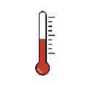
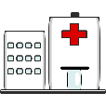
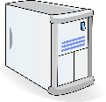
ID modeling workflow
Data collection
Modeling
Communication
Sick people
Health care system
Data aggregation
Decision makers
ID model
Other data sources
General public
8
Notes:
Here’s a high-level view of the modeling process.
First, people get sick and interact with the health care system, usually by getting tested or being hospitalized.
This sort of data gets collected by health care facilities and is then aggregated at the state level by public health disease surveillance systems.
This aggregated data on disease outcomes can be combined with other data sources – depending on the model, these data can include all kinds of things like vaccinations, weather, cell phone mobility metrics, and survey data on behaviors like masking.
Someone then builds a new model that uses these data to explore the questions they’re interested in, or inputs what they have into an existing model.
- generally, it is a bit of an iterative process of fitting the model to the different sources of data
Once the model results are ready, these can be communicated with public health decision makers and to the public,

Slide 9
What do we actually measure?
What we want to know | What we can measure
How many people are infected?
How much transmission is happening?
How much burden is COVID-19 putting on people?
How much burden is COVID-19 putting on our health care system?
What might happen going forward?
What can we do about this?
9
Notes:
I want to step out a bit and ask the question – what it is it that we actually want to know? In particular, what is it we want to know about the infectious disease dynamics in the population.
How many people are infected?
How much transmission is happening?
- Relative transmission, the number of people becoming infected per infected individual, otherwise known as Re, is very useful to know on it’s own, as it governs short-term behavior of the pandemic. Taken together, the number of people who are infectious and the transmission tells us more. If we have both high transmission and a large number of infectious people, we know infections will grow extremely quickly, and we made need to take immediate steps to mitigate. On the other hand, if we have high relative transmission and low numbers of infectious individuals, we have the opportunity to
How much burden is COVID-19 putting on people?
How much burden is COVID-19 putting on our health care system?
What might happen going forward?
What can we do about this?

Slide 10
What do we actually measure?
What we want to know | What we can measure
How many people are infected? | How many cases are occurring
How much transmission is happening? | Very difficult to directly measure
How much burden is COVID-19 putting on people? | Good measurement on severe health outcomes (hospital admissions and deaths from COVID-19) Less information on economic, educational, and psychological burden Less information on who the burden is falling on
How much burden is COVID-19 putting on our health care system?
What might happen going forward?
What can we do about this?
10
Notes:
Now let’s look at what we actually measure from surveillance:
Despite the loose use of language (everywhere), we do not have any direct data on the number of infections, only the number of detected infections (called cases), which we know is much less than the actual number of infections.
Transmission is very difficult to directly measure – we have some observations of this from case and contact investigation, but the focus on these efforts is on prevention of further spread, not providing in depth data that we could use to directly measure transmission.
How much burden is COVID-19 putting on people? – We do have good data on this – in WA in particular we have the RHINO system which captures 100% of ED and inpatient visits.
We have much less information on economic, educational and psychological burden
And also less information on who the burden is falling on – race and ethnicity groupings, SES, employment etc
How much burden is COVID-19 putting on our health care system?
This we do have good data on
What might happen going forward?
What can we do about this?
These we cannot directly measure

Slide 11
ID modeling workflow
Data collection
Modeling
Communication
Sick people
Health care system
Data aggregation
Decision makers
What we measure:
Cases
Hospital admissions
Deaths
ID model
What we want to know:
Infections
Transmissions
What might happen
Other data sources
General public
11
Notes:
So going back to the workflow, one way to think about the modeling is taking what we can measure and helping translate that into what we would like to know in terms of infectious disease dynamics in the population

Slide 12
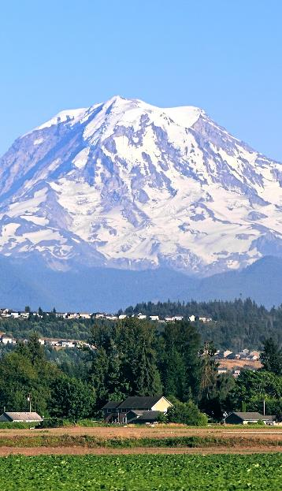
Washington state data sources
Tests and cases (WDRS)
Hospitalizations (WDRS, RHINO, WA Health)
Deaths
Vaccinations – ~95% complete
Seroprevalence (CDC)
Sequence data
Wastewater data
12
Notes:
Washington State is a ‘home rule’ state – responsibility for public health lies with individual local health jurisdictions – typically at the county or tribal level. The Washington State Department of Health provides some common functionality to local health jurisdictions. In particular there is a state-wide notifiable condition reporting system that is run by the department of health and used by DOH and local health jusidictions. Major omission has been access to tribal health authorities – this is changing.
Notifiable conditions are required to be reported to Department of Health or local health jurisdictions, and go into a system called the Washington Disease Reporting System (WDRS). Most reports are made electronically from the labs doing the diagnosis, but some are reported by other means, including fax, and are hand entered into the system. A rule change was made for COVID to require all test results for COVID, including negative test results, to be reported to WDRS. Eventually this overwhelmed WDRS
WDRS is used for case management, especially contact tracing and notification, but also for surveillance purposes. Prior to COVID however examination of specific trends might happen once or twice a year.
- Hospitalizations are reported electronically to DOH and CDC as part of National Syndromic Surveillance Program. At DOH this goes into a system called RHINO This information however does not necessarily include high quality diagnoses, and we link the RHINO to the lab data in WDRS to determine hospitalizations with COIVD. RHINO also provides syndrome information, including a specific syndrome called Covid Like Illness (CLI), that is purely based on symptoms.
We also now get information provided separately by the hospitals into a system called WA Health, which is designed to monitor hospital capacity, and includes daily admissions for COVID-19, beds occupied by COVID-19 patients, and available beds.
- Death data comes from our vital records system, and is linked to WDRS test data to determine if a person who dies had recently tested positive for COVID (small amount of post-mortom testing as well). These are then checked in detail to determine if the infection was the likely cause of death.
Cases and vaccinations are geocoded to the census tract level.
Around 95% of vaccinations that occur in Washington are reported to our Immunization Information system (the other 5% are mostly federally administered doses and only reported to the CDC). This data is generally provided by the provider administering the vaccination, and is generally of high quality. This data is linked to the test, hospitalization and death data.
We also make some use of the seroprevalence data provided by the commercial lab testing program at the CDC.
Sequencing is performed on a proportion of positive tests by a handful of labs, including DOH lab, UW virology, SCAN and a couple of commercial labs.
We don’t currently make use of wastewater surveillance data

Slide 13
SEIR model
Susceptible
Exposed
Infectious
Recovered/ Currently Immune
Immune escape / waning
Vaccination
Deceased
13
Notes:
Now we’re going to take a look at one very common type of infectious disease model, which is called an SEIR model.
This is a simplification of that
What defines an SEIR model are the four S-E-I-R compartments that people move through - these stand for Susceptible, Exposed, Infectious, and Recovered.
Initially everyone is considered susceptible, until the virus enters someone's system, at which point they're considered exposed (note that this is different than other uses of the term exposed where someone just came into contact with an infectious person).
After some period of time, that person is assumed to become infectious to others, and then after another period of time they eventually either die and are removed from the model population, or move to the recovered compartment where they are no longer infectious and have immunity for some time.
With models for some diseases, people progress through the compartments in only one direction, but others like COVID can be a bit more complicated.
[click] Sometimes there’s a vaccine. When people who were previously susceptible get vaccinated, we move some portion of them (depending on how effective the vaccine is) directly from the Susceptible compartment to the Recovered compartment.
[click] Likewise, for some diseases immunity is not permanent. With COVID, people’s immunity wanes over time, or if a new variant comes along that bypasses previous immunity, they get moved from the Recovered compartment back to Susceptible.

Slide 14
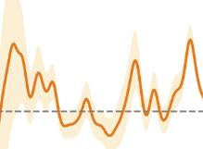
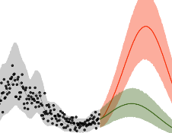
SEIR modeling workflow
Epi data
Test results
Hospitalizations
Deaths
Estimated historic & recent transmission
SEIR Model
Vaccination data
# 1st / 2nd doses
# Boosters
Scientific Literature
Infection-outcome ratios
Vaccine efficacy & waning
Scenario projections
14
Notes:
SEIR models can vary by what kind of data and outcomes they focus on, but here's a general overview of how one might work.
As we mentioned before, a model for an existing virus would take in various epi data like test results, hospitalizations and deaths, and vaccine doses administered. These data could all be basic counts by week, or they could be daily counts broken down by age and other factors.
All of these data are observable outcomes, but to paint a picture of the entire epidemic we also need to make estimates about everyone who’s gotten the virus, including people who never got tested.
To bridge this gap, SEIR models typically use various assumptions taken from studies, such as ratios of the number of infections per hospitalization by age. With this sort of information, the model might estimate that, for every 65-year-old that ends up in the hospital, there were probably about 10 total infections that occurred.
Some of those 9 other people likely tested positive, but it’s also likely that some never got tested and wouldn’t otherwise show up in our data anywhere).
So, by incorporating all these data and assumptions, the model is able to paint a picture of what recent transmission looks like and how it's changed over time
And once we have a picture of the current state of things, we can use the model to run some scenarios estimating what might happen if transmission were to continue at its recent pace, or get better or worse by some degree.

Slide 15
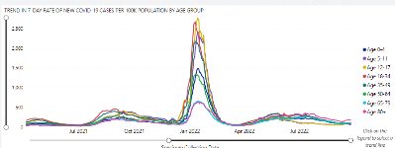
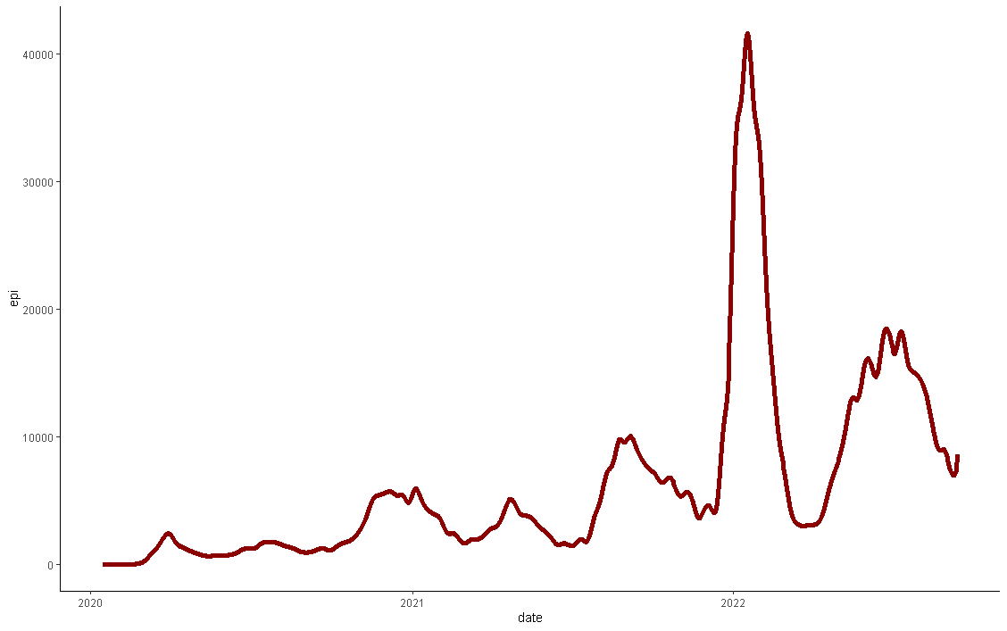
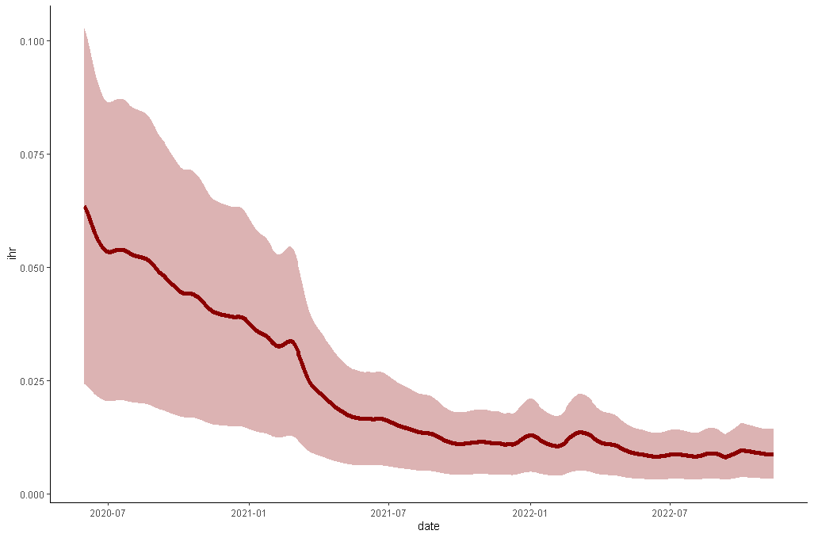
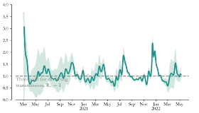
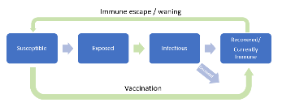
Analytic process
Hospital admissions
Infection epi-curve
Case count curves
Serology data
Infection hospitalization rate (IHR)
SEIR model
Model parameters
Incubation period
Infectious period
Waning of immunity(s)
Immunity(s) from vaccination
Transmission
Prevalence
Immunity
15
Notes:
The next couple of slides will look at this process in a little more detail, as it is instructive as to the kinds of things that need to go into the modeling process.
This slide shows the general process, which revolves around producing an epi-curve of infections – an estimate of the number of infections that are occurring each day. This, together with model parameters, drives the model to produce transmission, prevalence and immunity estimates
An important part of this diagram being glossed over is the estimation of the infection hospitalization rate

Slide 16
Infection hospitalization rate
Baseline IHR:
Variant effects
Immunity effects
Age distribution
IHR curve
16
Notes:
This is actually where most of the effort in the modeling goes.
We start with an estimate of the baseline IHR taken from the literature. This estimate is by age group, and only applied during the earlier days of the epidemic.
We need to modify this estimate for variant severity. To do this we need estimates from the literature of both variant severity and data on variant proportions. Fortunately we have a robust sequencing program to get these proportions
Since these change over time we now have a time varying IHR
We also need to take into account the effects of various types of immunity on IHR, both from vaccination and from prior infections.
Effects of vaccination require estimates of immunity and waning of immunity, but type of vaccination and by variant. We get these estimates from data published by UK public health.
We apply these estimates to the population vaccination status in Washington State, using data from the information immunization system. Note that the immunity parameters need to be for both infection and protection against severe illness, as it is differential between these that alters the infection hospitalization rate.
Similarly we need this information for prior infection. Protection and rates of waning estimates come from the literature, but we also need to know the number of prior infections, which could come from the model itself, or from other estimates such as serology data.
Finally, as all of these estimates done by age group, we need to know the distribution of infections by age in the population. We estimate this using a combination of population estimates, case counts, and serology data to estimate relative under-reporting of cases.
These are all mixed together to come up with the average IHR curve for the state.

Slide 17
Infection hospitalization rate
Baseline IHR:
Variant severity
Variant proportion
Variant immune escape
Variant effects
Immunity effects
Age distribution
IHR curve
17
Notes:
This is actually where most of the effort in the modeling goes.
We start with an estimate of the baseline IHR taken from the literature. This estimate is by age group, and only applied during the earlier days of the epidemic.
We need to modify this estimate for variant severity. To do this we need estimates from the literature of both variant severity and data on variant proportions. Fortunately we have a robust sequencing program to get these proportions
Since these change over time we now have a time varying IHR
We also need to take into account the effects of various types of immunity on IHR, both from vaccination and from prior infections.
Effects of vaccination require estimates of immunity and waning of immunity, but type of vaccination and by variant. We get these estimates from data published by UK public health.
We apply these estimates to the population vaccination status in Washington State, using data from the information immunization system. Note that the immunity parameters need to be for both infection and protection against severe illness, as it is differential between these that alters the infection hospitalization rate.
Similarly we need this information for prior infection. Protection and rates of waning estimates come from the literature, but we also need to know the number of prior infections, which could come from the model itself, or from other estimates such as serology data.
Finally, as all of these estimates done by age group, we need to know the distribution of infections by age in the population. We estimate this using a combination of population estimates, case counts, and serology data to estimate relative under-reporting of cases.
These are all mixed together to come up with the average IHR curve for the state.

Slide 18
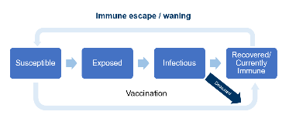
Infection hospitalization rate
Baseline IHR:
Variant severity
Variant proportion
Variant immune escape
Variant effects
Waning of immunity(s) from vaccination
Vaccination status by time since vaccination
Waning of immunity(s) from prior infection
Prior infection estimates
Immunity effects
Age distribution
SEIR model
IHR curve
18
Notes:
This is actually where most of the effort in the modeling goes.
We start with an estimate of the baseline IHR taken from the literature. This estimate is by age group, and only applied during the earlier days of the epidemic.
We need to modify this estimate for variant severity. To do this we need estimates from the literature of both variant severity and data on variant proportions. Fortunately we have a robust sequencing program to get these proportions
Since these change over time we now have a time varying IHR
We also need to take into account the effects of various types of immunity on IHR, both from vaccination and from prior infections.
Effects of vaccination require estimates of immunity and waning of immunity, but type of vaccination and by variant. We get these estimates from data published by UK public health.
We apply these estimates to the population vaccination status in Washington State, using data from the information immunization system. Note that the immunity parameters need to be for both infection and protection against severe illness, as it is differential between these that alters the infection hospitalization rate.
Similarly we need this information for prior infection. Protection and rates of waning estimates come from the literature, but we also need to know the number of prior infections, which could come from the model itself, or from other estimates such as serology data.
Finally, as all of these estimates done by age group, we need to know the distribution of infections by age in the population. We estimate this using a combination of population estimates, case counts, and serology data to estimate relative under-reporting of cases.
These are all mixed together to come up with the average IHR curve for the state.

Slide 19
Infection hospitalization rate
Baseline IHR:
Variant severity
Variant proportion
Variant immune escape
Variant effects
Waning of immunity(s) from vaccination
Vaccination status by time since vaccination
Waning of immunity(s) from prior infection
Prior infection estimates
Immunity effects
Population estimates
Case counts
Serology
Age distribution
SEIR model
IHR curve
19
Notes:
This is actually where most of the effort in the modeling goes.
We start with an estimate of the baseline IHR taken from the literature. This estimate is by age group, and only applied during the earlier days of the epidemic.
We need to modify this estimate for variant severity. To do this we need estimates from the literature of both variant severity and data on variant proportions. Fortunately we have a robust sequencing program to get these proportions
Since these change over time we now have a time varying IHR
We also need to take into account the effects of various types of immunity on IHR, both from vaccination and from prior infections.
Effects of vaccination require estimates of immunity and waning of immunity, but type of vaccination and by variant. We get these estimates from data published by UK public health.
We apply these estimates to the population vaccination status in Washington State, using data from the information immunization system. Note that the immunity parameters need to be for both infection and protection against severe illness, as it is differential between these that alters the infection hospitalization rate.
Similarly we need this information for prior infection. Protection and rates of waning estimates come from the literature, but we also need to know the number of prior infections, which could come from the model itself, or from other estimates such as serology data.
Finally, as all of these estimates done by age group, we need to know the distribution of infections by age in the population. We estimate this using a combination of population estimates, case counts, and serology data to estimate relative under-reporting of cases.
These are all mixed together to come up with the average IHR curve for the state.

Slide 20
Question for the Audience
What barriers do you face in working with outside partners on data science projects during public health emergencies?
Access to data
Access to suitable partners
Data sharing challenges
Communicating needs and capabilities
Other (Type in chat)
20
Notes:
Read slide – select all that apply

Slide 21
How we use modeling
21

Slide 22
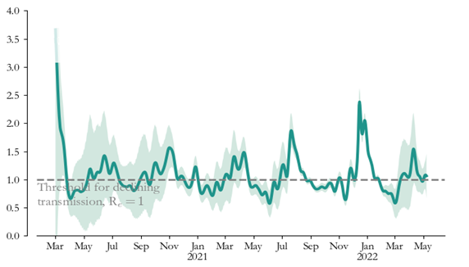
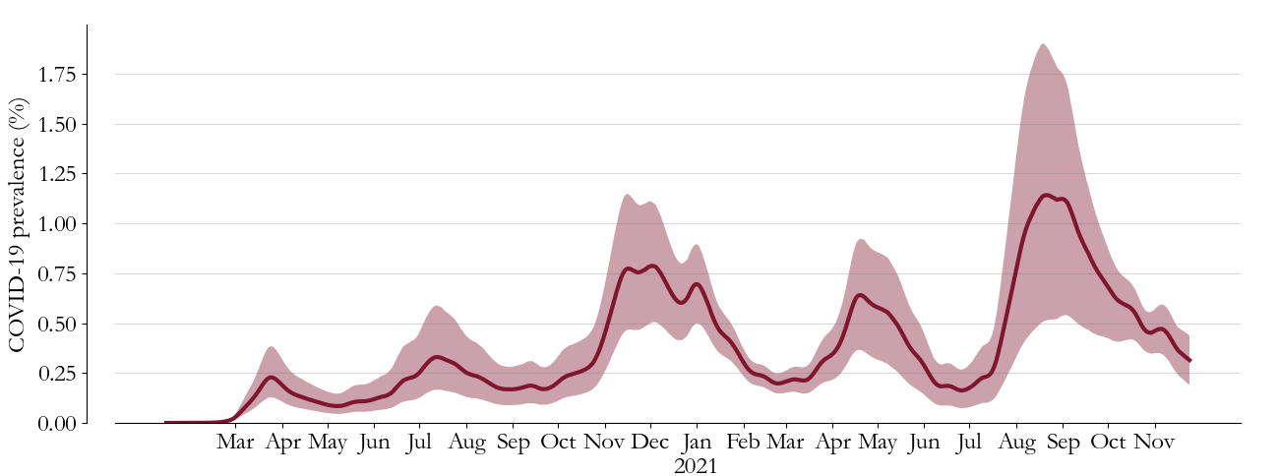
Case 1: Current situation
Population diagnostic machine:
What is currently happening with disease transmission?
R effective
Prevalence
Immunity
22
Notes:
- We have primarily used modeling as a window into what is currently happening with disease transmission
A secondary use has been for scenario projections, in particular hospital admissions
Most of the modeling has either been done separately for Eastern and western Washington, or at the state level as a whole once things become similar enough. Specific models for King County and Yakima in particular have also been used.

Slide 23
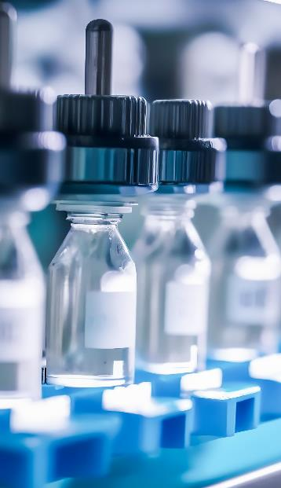
Case 2: Scenario projections
Projections require additional assumptions:
Future changes in transmission (Seasonal, Behavioral)
Future vaccination rates
New variant properties
Projections based on assumptions about the effect of specific scenarios on future transmission
Transmission assumptions feed into the model to project future admissions
23
Notes:
- We have primarily used modeling as a window into what is currently happening with disease transmission
A secondary use has been for scenario projections, in particular hospital admissions
Most of the modeling has either been done separately for Eastern and western Washington, or at the state level as a whole once things become similar enough. Specific models for King County and Yakima in particular have also been used.

Slide 24
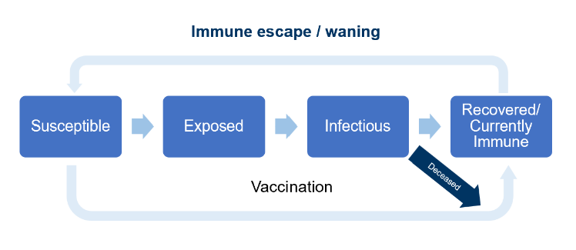
Case 2: Scenario projections
Estimation
Hospital Admissions
Infection Epi-curve
IHR
Incubation period
Infectious period
Immune escape
Transmission
24
Notes:
- We have primarily used modeling as a window into what is currently happening with disease transmission
A secondary use has been for scenario projections, in particular hospital admissions
Most of the modeling has either been done separately for Eastern and western Washington, or at the state level as a whole once things become similar enough. Specific models for King County and Yakima in particular have also been used.

Slide 25
Case 2: Scenario projections
Hospital Admissions
Infection Epi-curve
IHR
Incubation period
Infectious period
Immune escape
Projection
Transmission
25
Notes:
- We have primarily used modeling as a window into what is currently happening with disease transmission
A secondary use has been for scenario projections, in particular hospital admissions
Most of the modeling has either been done separately for Eastern and western Washington, or at the state level as a whole once things become similar enough. Specific models for King County and Yakima in particular have also been used.

Slide 26
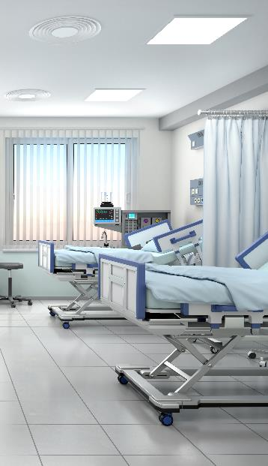
Case 2: Scenario projections
Infections are projected directly from the model
Hospital admissions are calculated based on future IHR
Beds occupied are inferred from the hospital admissions and length of stay distribution, scaled to match WA health data
26
Notes:
- We have primarily used modeling as a window into what is currently happening with disease transmission
A secondary use has been for scenario projections, in particular hospital admissions
Most of the modeling has either been done separately for Eastern and western Washington, or at the state level as a whole once things become similar enough. Specific models for King County and Yakima in particular have also been used.

Slide 27
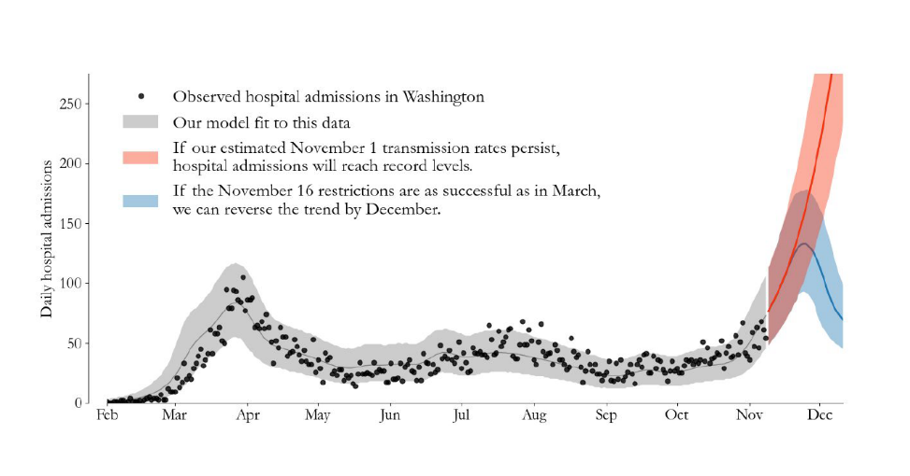
Case 1: Modeling to inform policy
November 16, 2020 restrictions
27
Notes:
- We have primarily used modeling as a window into what is currently happening with disease transmission
A secondary use has been for scenario projections, in particular hospital admissions
Most of the modeling has either been done separately for Eastern and western Washington, or at the state level as a whole once things become similar enough. Specific models for King County and Yakima in particular have also been used.

Slide 28
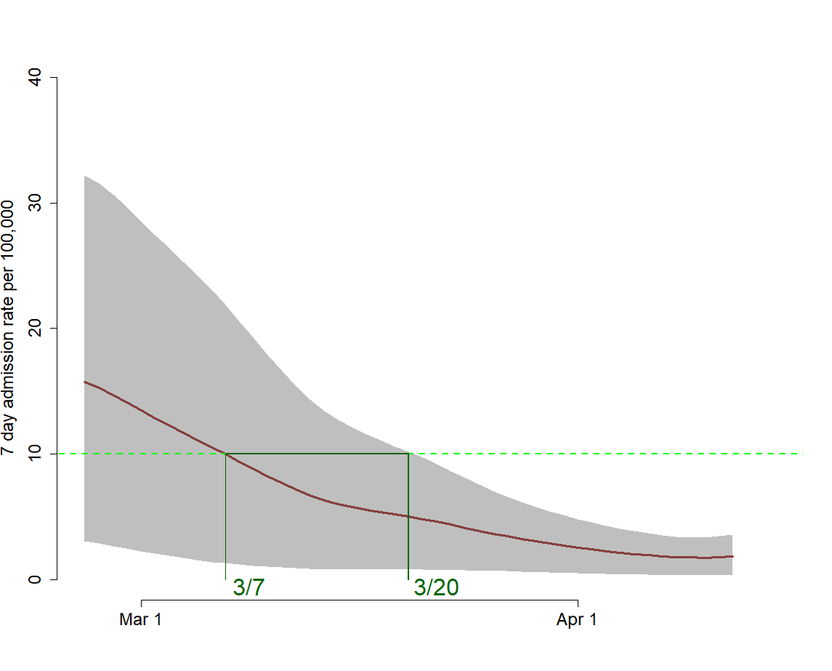
Case 2: Modeling to inform policy
Projected hospital admissions and 90% prediction interval
Projected date at which admissions drop to CDC community criteria
Model estimate: 10 admissions per 7 days per 100,000 between 2/25 – 3/20 (90% prediction interval) with a best estimate of March 7
28
Notes:
- We have primarily used modeling as a window into what is currently happening with disease transmission
A secondary use has been for scenario projections, in particular hospital admissions
Most of the modeling has either been done separately for Eastern and western Washington, or at the state level as a whole once things become similar enough. Specific models for King County and Yakima in particular have also been used.

Slide 29
Question for the Audience
What is the biggest challenge your face in your work with data?
Getting quality data
Finding the right partnerships
Having receptive leadership
Insufficient technical support
All of the above
Other (Type in chat)
29
Notes:
Read slide.

Slide 30
Equity: What do we want to know?
Who is getting infected?
Age, race and ethnicity, employment, socioeconomic status
Where is transmission happening?
Household, household size, workplace, type of work, other
Who is being burdened by COVID-19?
Age, race and ethnicity, employment, socioeconomic status
Who will be burdened going forward?
How can we ensure equitable policy decisions?
30
Notes:
In terms of incorporating equity into modeling, I want to step back to the original questions about infectious disease dynamics and reframe these.

Slide 31
Reflection
Relationship with academic and not-for-profit modelers was very valuable to WADOH
Importance of science communication
Collaborations with other west coast states
Benefit of receptive leadership
Challenges: getting/giving data, data quality, model updates
31
Notes:
Relationship with IDM was extraordinarily valuable to DOH
Importance of science communication
Receptive leadership
Challenges
Getting/giving data, data quality

Slide 32
Resources
Infectious Disease Models for Decision Makers (free online course) https://www.coursera.org/learn/infectious-disease-transmission-models-for-decision-makers
Example modeling situation report for Washington State
https://doh.wa.gov/sites/default/files/2022-03/820-114-SituationReport-20210922.pdf?uid=6480bd2762506
University of Washington Summer Institute Statistics and Modeling for Infectious Diseases
https://si.biostat.washington.edu/institutes/sismid
General Infectious Disease Epidemiology and Modeling Resources
https://andreashandel.github.io/IDEMAcourse/General_Resources.html
32

Slide 33
To ask a question, please click the Q&A icon in the Zoom toolbar to open your Q&A Pod.

